Slide 1

Checkpoint :
GitHub
samah MAANED

Slide 2


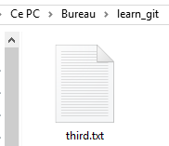
Creating a folder called ‘learn_git’ :
2. Changing the repository into the learn_git folder:
3. Creating a file called “third.txt”:

Slide 3


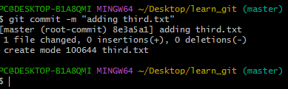
4. Initializing an empty git repository: command “gitinit”:
5. Adding “third.txt” to the staging area:
6. Commit with the message "adding third.txt":

Slide 4
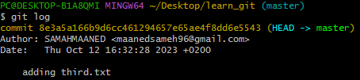


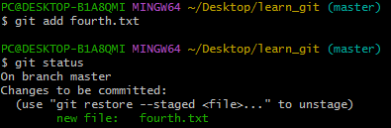
7. Checking the commit:
8. Creating a file called “fourth.txt”:
9. Adding fourth.txt to the staging area:

Slide 5


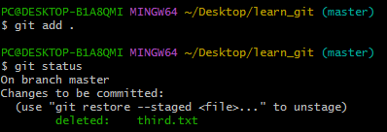
10. Commit with the message "adding fourth.txt":
11. Removing the third.txt file:
1. 12. Adding this change to the staging area:

Slide 6

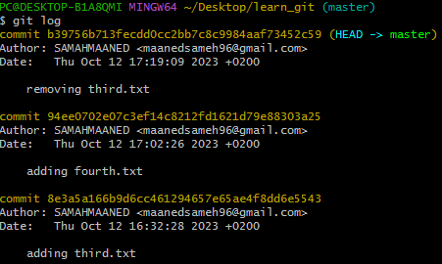
13. Commit with the message "removing third.txt":
14. Checking the commits:

Slide 7
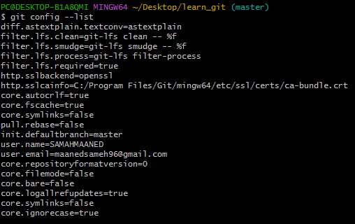
16. All the global configurations for git on my machine:

Slide 8
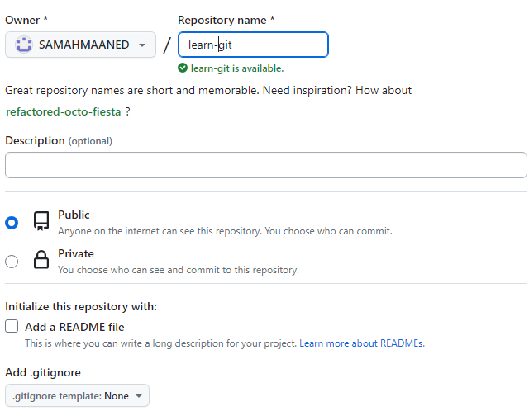

Slide 9
